Slide 1
USABILITY TESTING FOR A SAAS APPLICATION IN HEALTHCARE BY: ROHAN RANA (25%), ERIC MARGADONNA (25%), YANIS AMIRAT (25%), JOSEPH VICK (25%)

Slide 2

INTRODUCTION
Technological advancements in healthcare have proven critical in improving outcomes, reducing errors, improving efficiency, data tracking, and care coordination, among others (Liew et al., 2019).
The SaaS (Software-as-a-Service) technology, defined as a "service model in cloud computing used by vendors to provide complete packages of software applications to the customers through the internet."

Slide 3
CONT.
The integration of SaaS in healthcare has replaced traditional software usage by impacting the need to host and own hardware.
This is based on the fact that SaaS applications in healthcare allow users to install, operate, and manage software applications on either their mobile phones or web-based platforms (Russ & Saleem, 2018).
The positive impacts of these platforms range from efficiency, high provisioning to end-users and lower operational costs.

Slide 4
TEAM OBJECTIVES
•The topmost priority of the North Carolina Department of Health and Human Services (the Department) is the health and well-being of the individuals they serve.
•Our team has researched the usability testing of a SAAS application targeted for healthcare systems to be used by the served population.
•Target audience includes
•Children
•Elderly
•Disabled

Slide 5
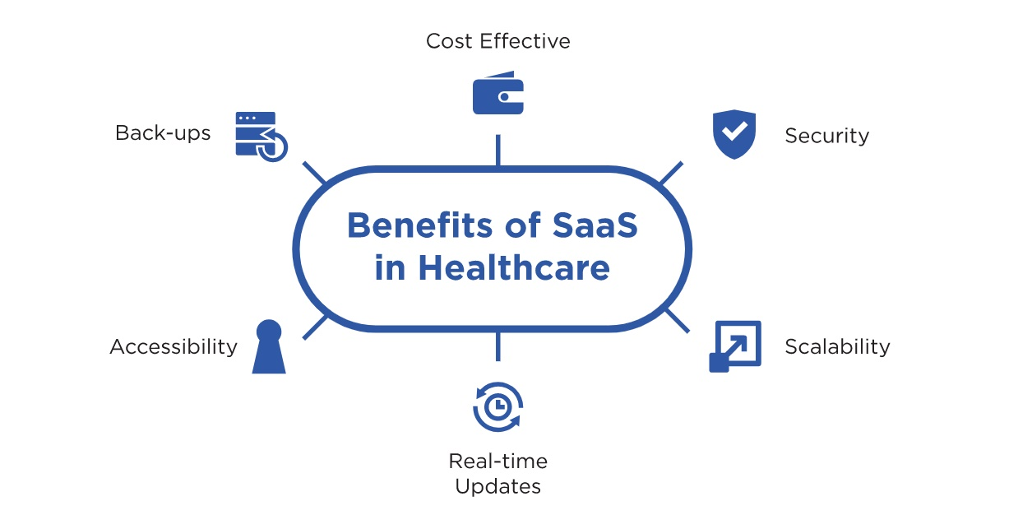
BENEFITS OF SAAS APPS IN HEALTHCARE
Notes:
data never get lost
any

Slide 6
USABILITY TESTING OF SAAS APPLICATIONS IN HEALTHCARE
Like many other technological advancements, the efficiency of applications is determined by numerous factors, including usability testing.
Usability testing in SaaS aims to ensure the right practices are employed in the development of applications and ensure they are developed to meet the needs of the users in an efficient, cost-effective, and patient-centred manner (Liew et al., 2019).

Slide 7
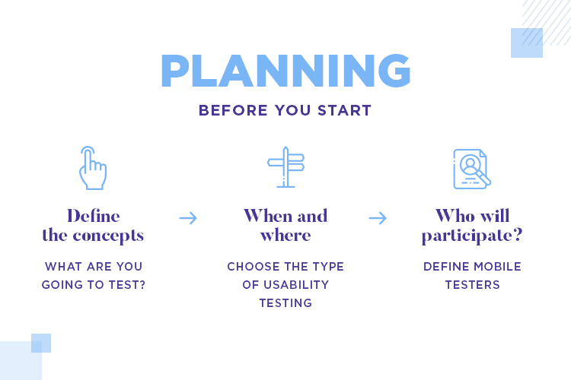
CONT.
The usability testing plan for the developed mobile/web application will comprise several steps, including;
Objectives
Creation of tasks
Creation of test documents
Recruiting participants
Implementing the testing method
Reporting the test findings

Slide 8
OBJECTIVES OF THE TEST
The first step revolves around the development of objectives.
As a mobile-based healthcare application, the objectives will guide the scenarios and the tasks.
This will ensure that the gathered date is applicable to the expected results and that the objectives will be achieved (Russ & Saleem, 2018).
Since the testing will be qualitative and quantitative, open, close-ended, and exploratory strategies will be used.

Slide 9
CREATION OF TASKS
Task development will be centered on the most used functions of the developed software.
These tasks should be the most essential in terms of clinical care and patient safety.
The creation of tasks will also provide significant analysis of other application functions (Liew et al., 2019).
The tasks created for testing the usability of the app will be realistic, actionable, ordered in a sequence to ensure smooth transitions and tied to the objectives
No clues will be provided in the testing phase.

Slide 10
CREATION OF TEST DOCUMENTS
Several test documents will be deployed in the usability testing process. These documents may include consent forms for participants and questionnaires based on the engaged data collection methods, including post-test questionnaires.
Test documents will be developed in consideration of the role of end-users (participants/targeted population) and the targeted performance goals (Russ & Saleem, 2018).

Slide 11
RECRUITING PARTICIPANTS
The selected participants will be a representation of the expected end-users.
As a healthcare application, the recruitment process will include participants from all healthcare dimensions. This means it will include novice to experts, individuals from different age groups with different literacy levels, and clinical proficiency, among other factors (Russ & Saleem, 2018).
Input from healthcare administrators and professionals will also be considered to help define the potential range of end-use roles (Liew et al., 2019).

Slide 12
IMPLEMENTING THE TESTING METHODS
The testing methods to be implemented will include questionnaires, task completion, focus groups and interviews.
The procedure may include signing the forms (consent), pretest interview, carrying out the tasks, completion of post-test questionnaires, a post-test interview, and debriefing (Liew et al., 2019).
Debriefing aims at gaining additional insights into why the participants engaged in specific actions and the problems they may have encountered.

Slide 13
REPORTING THE FINDINGS
The gathered data will be analyzed to identify the app's effectiveness based on the intended goals, examine the underlying issues, develop solutions, and explore the application's applicability in healthcare (Liew et al., 2019).
Other elements to be considered will include privacy, security and the risks to end-users.

Slide 14
CONCLUSION
Usability Testing is a critical aspect in examining the friendliness and effectiveness of applications towards the users and the intended goals.
For this study, usability testing will be used to identify the gaps existing in the application of the app, in relation to improved healthcare outcomes and healthcare experiences.

Slide 15
REFERENCES
Liew, M. S., Zhang, J., See, J., & Ong, Y. L. (2019). Usability Challenges for Health and Wellness Mobile Apps: Mixed-Methods Study Among mHealth Experts and Consumers. JMIR MHealth and UHealth, 7(1), e12160. https://doi.org/10.2196/12160
Russ, A. L., & Saleem, J. J. (2018). Ten factors to consider when developing usability scenarios and tasks for health information technology. Journal of Biomedical Informatics, 78, 123–133. https://doi.org/10.1016/j.jbi.2018.01.001

